Slide 1
ELI Scientific Data Management System
Teodor Ivănoaica
Sr Coordinator for Scientific Computing and Data Management

Slide 2

AGENDA
Data @ELI – Definitions, roles and (support) policies
ELI User Journey – The data perspective
SDMS - Design Principles and scientific community standards
ELI ERIC Scientific Data Management System Concept
Next Steps

Slide 3
ELI ERIC Statute
Article 13 Data Policy
13(1) ‘Data’ refers to all information collected by USERS and the staff while performing scientific experiments under the ACCESS FOR USERS Policy and performing operations of the ELI FACILITIES.
13(2) Open Access to FAIR data sets and metadata stored in Open Access repositories shall be favoured for data collected as a result of the use of the ELI FACILITIES and, to the extent possible in case of software and computer programmes created by the ELI ERIC and the ELI FACILITIES; open source principles shall be considered.
ELI ERIC role, as CUSTODIAN of the Data: “ELI ERIC shall be the custodian of and steward for the Data, with the responsibility to collect, secure, archive and provide access to the Data. ELI ERIC shall aim at managing Data according to the ‘FAIR’ principles, meaning that Data shall be Findable, Accessible, Interoperable and organised in Reusable datasets.”
ELI Data Policy has been developed and will soon be submitted to the International Scientific and Technical Advisory Committee. Expected to be adopted by the end of the year.
“Data Policy governs the management of and access to data relevant to perform and calibrate experiments as well as from experiments performed at the Extreme Light Infrastructure ERIC (ELI ERIC). It pertains to the curation, storage and access to data and metadata collected from the operation and scientific usage of the ELI Facilities."
For a consistent and efficient implementation of the policies, an integrated Scientific Data Management System is needed!

Slide 4
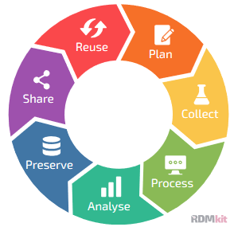
What is Scientific Data Management? How does it support users?
It is ELI’s Research Data Management Plan. It is the collection of practices helping us plan, collect, process, analyse, preserve, share and make data re-usable.
•Data management planning – the DMP – reflecting the data lifecycle
•Collecting raw data and metadata – Curation and correlation
•Processing to produce new data
•Analysing data to produce results
•Curating data for the long term
•Sharing data and making it Findable, Accessible, Interoperable and Reusable
The direct impact of FAIR:
Facilitates new data
Derived data produced
Enables new research
Accelerates science

Slide 5
Common challenges are building communities!
What the users communities are asking:
What Funders are asking:
What is happening pre/after discussing data?
Good (meta)data + logbooks
Performant Download services
Digital Object Identifiers for Data
Remote data analysis
Access to Open Data
Credit for Data re-use
User: has an idea / need to study a sample
Proposal: User writes a proposal for one of the PaN facilities
Review committee: Reviews proposal and rates scientific quality
Beamline scientist: Review proposal and checks feasibility
Beamtime allocated: User travels to facility / sends sample
Experiment: Sample(s) are exposed to beam + data collected
Analysis:Data is reduced, analysed+ curated (DOI)
Publication: User publishes results (DOI) in peer review journal
FAIR Data
Open Science
Digital Object Identifiers for Data
Reproducible Publications
Participate in the EOSC
Metrics about Data Re-Use

Slide 6











PaNOSC community we keep building on
Communities support
UmbrellaID
Training platform
VISA Remote analysis
PaN
Data portal
Common data policy
Software Catalogue
Jupyter Notebooks
FAIR data policy
DMPs
2010 2015 2018 2021 2022
DiTARI
eRImote
6

Slide 7

What PaNOSC does:
Policies supporting adoption of FAIR policies:
Data Policy Framework - https://zenodo.org/record/3862701
Data Policy guidelines - https://zenodo.org/record/4899344
Tools and services:
AAI
File Cataloguing solutions and support
Data tools:
Data portal
Data transfer tools and solutions for PaN
…………………..
PaNOSC is more than tools, is the community sharing the same challenges, same standards and working together to find unique solutions.

Slide 8
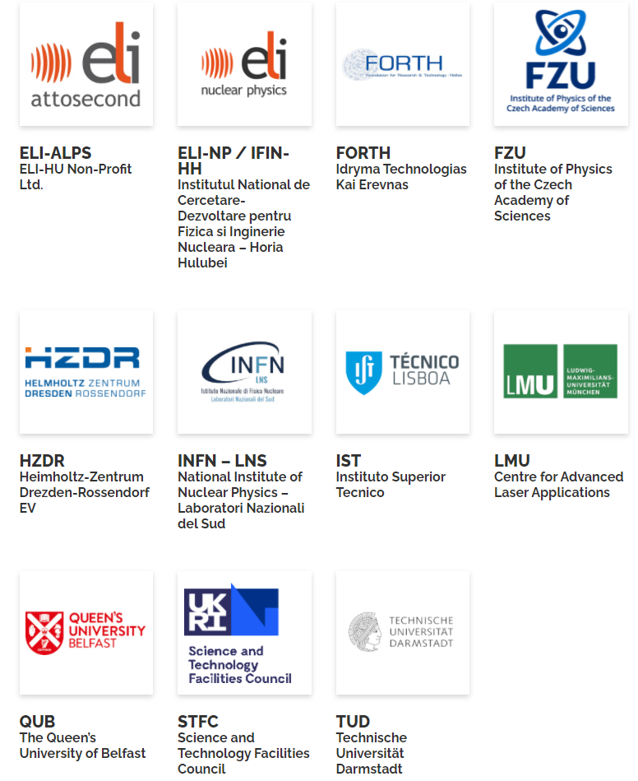
Specific ELI Input for implementing FAIR Principles.
IMPULSE Project Goal: A global platform for high-power laser science and development, uniting the facilities of the Extreme Light Infrastructure together.
Provides the necessary support for having the FAIR principles and all tools and services implemented based on ELI Specific requirements.
Major outcomes that are already used in the design:
Users office workflow and user portal processes - supporting the implementation of the DMP;
Simulation software expected to improve operations – supporting the data analysis and simulation services for users;
CS teams are joining efforts – accelerating the development of data tagging, data correlation and data curation processes;
…….
Most of the activities are boosting the design and implementation of the Data Policies and data services.

Slide 9



ELI Users’ Journey, the Data Perspective!
The Data Policy provides the necessary support to address the above challenges and implement tools and services supporting users and users’ activity!
We have the metadata, CS is actively engaging with users to identify/collect/secure:
Data Policy
Data Policy
DMP
DMP
data
*metadata is the key for searchable/reproducible data, it does not contain the data but it contains enough information to reproduce a data set/conditions that could be used to reproduce that dataset.(https://en.wikipedia.org/wiki/Metadata)
*rich metadata (https://zenodo.org/record/3862701#.YW-xLxpByUk, https://www.go-fair.org/fair-principles/r1-metadata-richly-described-plurality-accurate-relevant-attributes/)
data
Data portals/ publications portals/data query
User portal
Data portals/ publications portals/data query
User portal
Storage
Experiment
Storage
Experiment
data+ metadata
data+ metadata
Access policies
Access policies
Access policies
metadata
Access policies
metadata
metadata
metadata
metadata
metadata
Storage
Storage
Storage
Long term
Hot storage/curation
Storage
Long term
Hot storage/curation
Rich metadata
Rich metadata
FAIR (Meta)DATA matters and makes a difference!
Data Policy
Data Policy
10/20/2021 ELI Beamlines User Conference 2021
ELI Scientific Data Management System
9

Slide 10

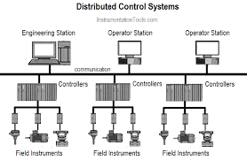
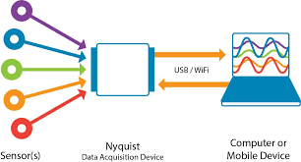



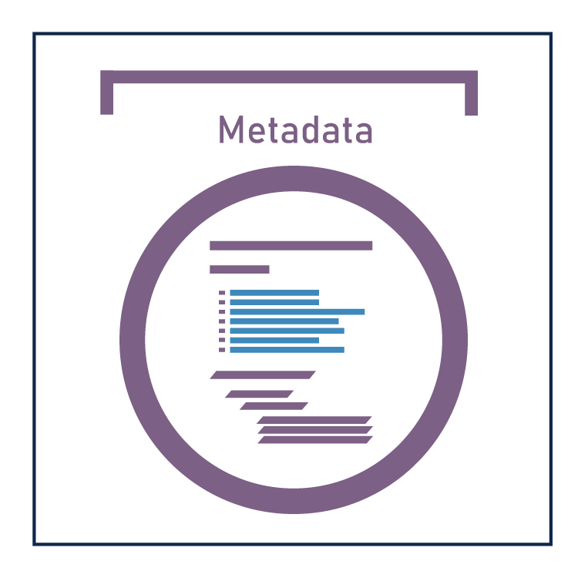







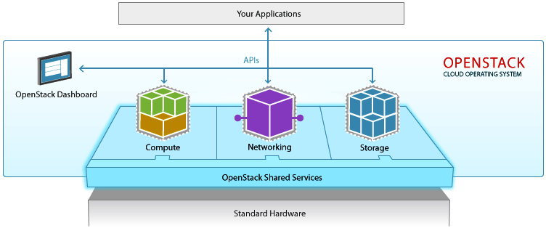

ELI ERIC Scientific computing data management
Unified Data and Computing Experience
Who?
Federated ID(providers):
Reuse existing:
AD
LDAP
Add :
UmbrellaID
ORCID
………….
Where from?
Identity Management
System?
Control/Operate
Acquire-generate (meta)data
Archivers etc
Online
storage
HOW?
Control Systems and DAQ
Proposal submission:
Technical feasibility
Scientific peer review
Approval
Scheduling
User portal
How to look for (Meta)DATA?
ELI ALPS/Beamlines/NP
Ingest Metadata
Make it searchable
WHAT?
??offline and Long Term Storage??
Internal portal:
Access for Authenticated users(PI)
Dedicated/reserved computing capacity
PaN Portal:
Open Data
Access based on Umbrella ID
Connection to EOSC
Where to analyse?
Highly Scalable
Easy to manage
Vendor agnostic
Automated provisioning
Software can be automatically distributed
ELI external portal for open data
ELI internal (embargoed data)
HPC
ELI Private Computing Cloud

Slide 11
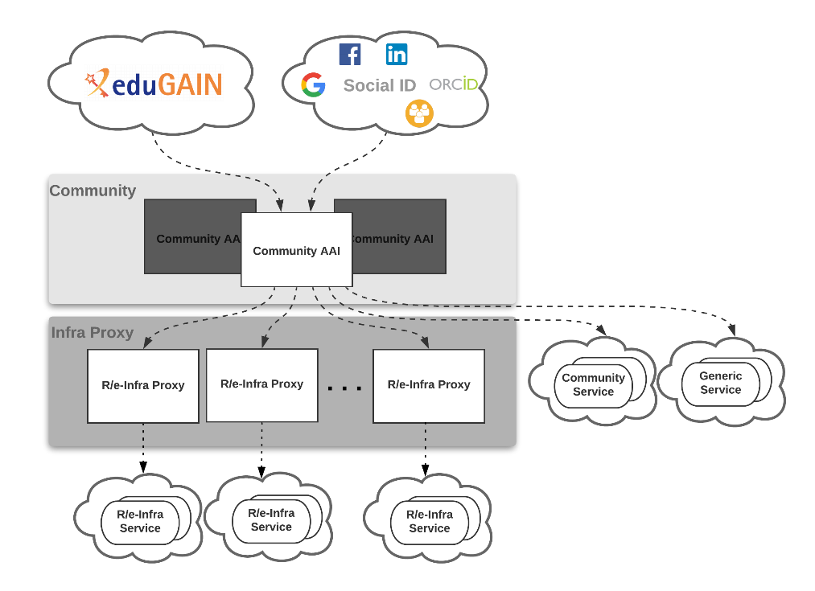




Supporting the users by providing a fully integrated Scientific Data Management System!
Concept!
Proposal &
Scheduling
System
2. Proposal Management System:
Development of Proposal Management Portal;
Implementing the DMP data collection;
Integration with Facility Scheduling System;
AAI
Authentication
ELI Data Portal
Authorization
ELI internal providers
ELI external portal for open data
Umbrella ID-Community services
ELI internal (embargoed data)

Slide 12
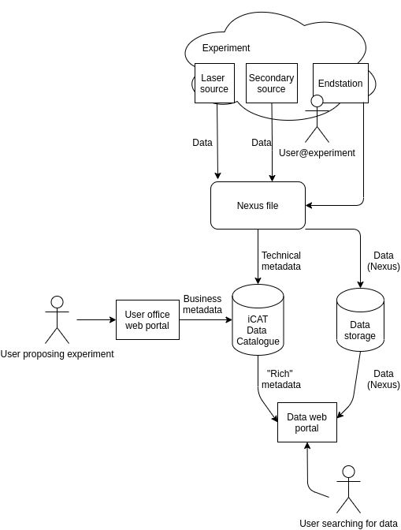
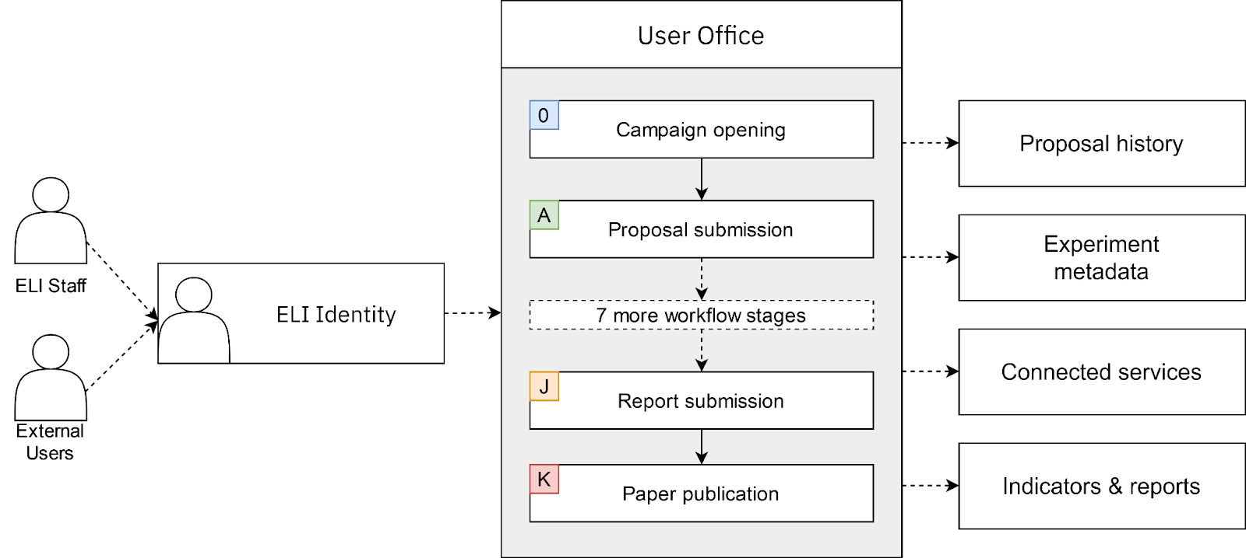
Catalogue integrations:
User creates proposal via User Office web portal
Defines what he wants to do, when and how
User does the experiment, the full data adhering to his dataset is saved into a single Nexus file
User wants to search for his old data/some other researcher’s data
Searches and downloads via the Data Portal web
Pilots:
User Portal - ICAT Pilot Project
@ELI ERIC

Slide 13
ELI ERIC Electronic Logbook project, started with one PhD student is ready to be tested:
– A pilot is discussed with ELI Beamlines CS
- Another pilot to be started also @ELI ALPS
Coherent notebook state for everyone
Simple, easy to share
Use julia
Distributed lookbooks technology
Pluto notebooks
Coherent notebook state for everyone
Simple, easy to share
Use julia
notebook
OpenAPI/
Swagger
Control systems
Sync
Swagger.jl can be used to generate a Julia package for the client interface form a .json spec.
notebook

Slide 14
NEXT Steps
ELI ALPS and Beamlines CS and IT teams are actively engaging users and identifying requirements/challenges/needs.
Data matters and users’ input adds value to data!
Based on the details we have collected:
Electronic logbook solution, allowing collaborative work has been identified – pilot project to be started with ELI Beamlines CS Team, a similar approach will be prepared with ELI Alps.
Data Curation and computing back-end strategy for supporting our users.
ACCELERATE the implementation of the Data Policy becomes a priority!

Slide 15
THANK YOU
ELI ERIC Computing Team
Teodor Ivanoaica
Martin Dostal
Jiri Bartos

